Slide 1


Assessment ideas for an AI enabled world
A menu of ideas to provoke discussion and reflection around assessment approaches in higher education.

Slide 2

The focus is on assessment design that enables students to develop foundational knowledge, skills and attributes that will help them thrive in an AI enabled world (with or without AI assistance).
Thank you to Lydia Arnold and others for sharing ideas to include in this resource. Menu design is based on Lydia Arnold’s ‘Top trumps (2022).
See end card for contributors.
Menu collated and customised by Dr Isobel Bowditch, Digital Assessment Advisor, UCL, supported by Jisc National Centre for Ai in tertiary education, Pam Birtill University of Leeds, Eddie Cowling University of York, Marieke Guy UCL, Cathy Minett-Smith University of West of England, Stephen Webb University of Portsmouth.

Slide 3


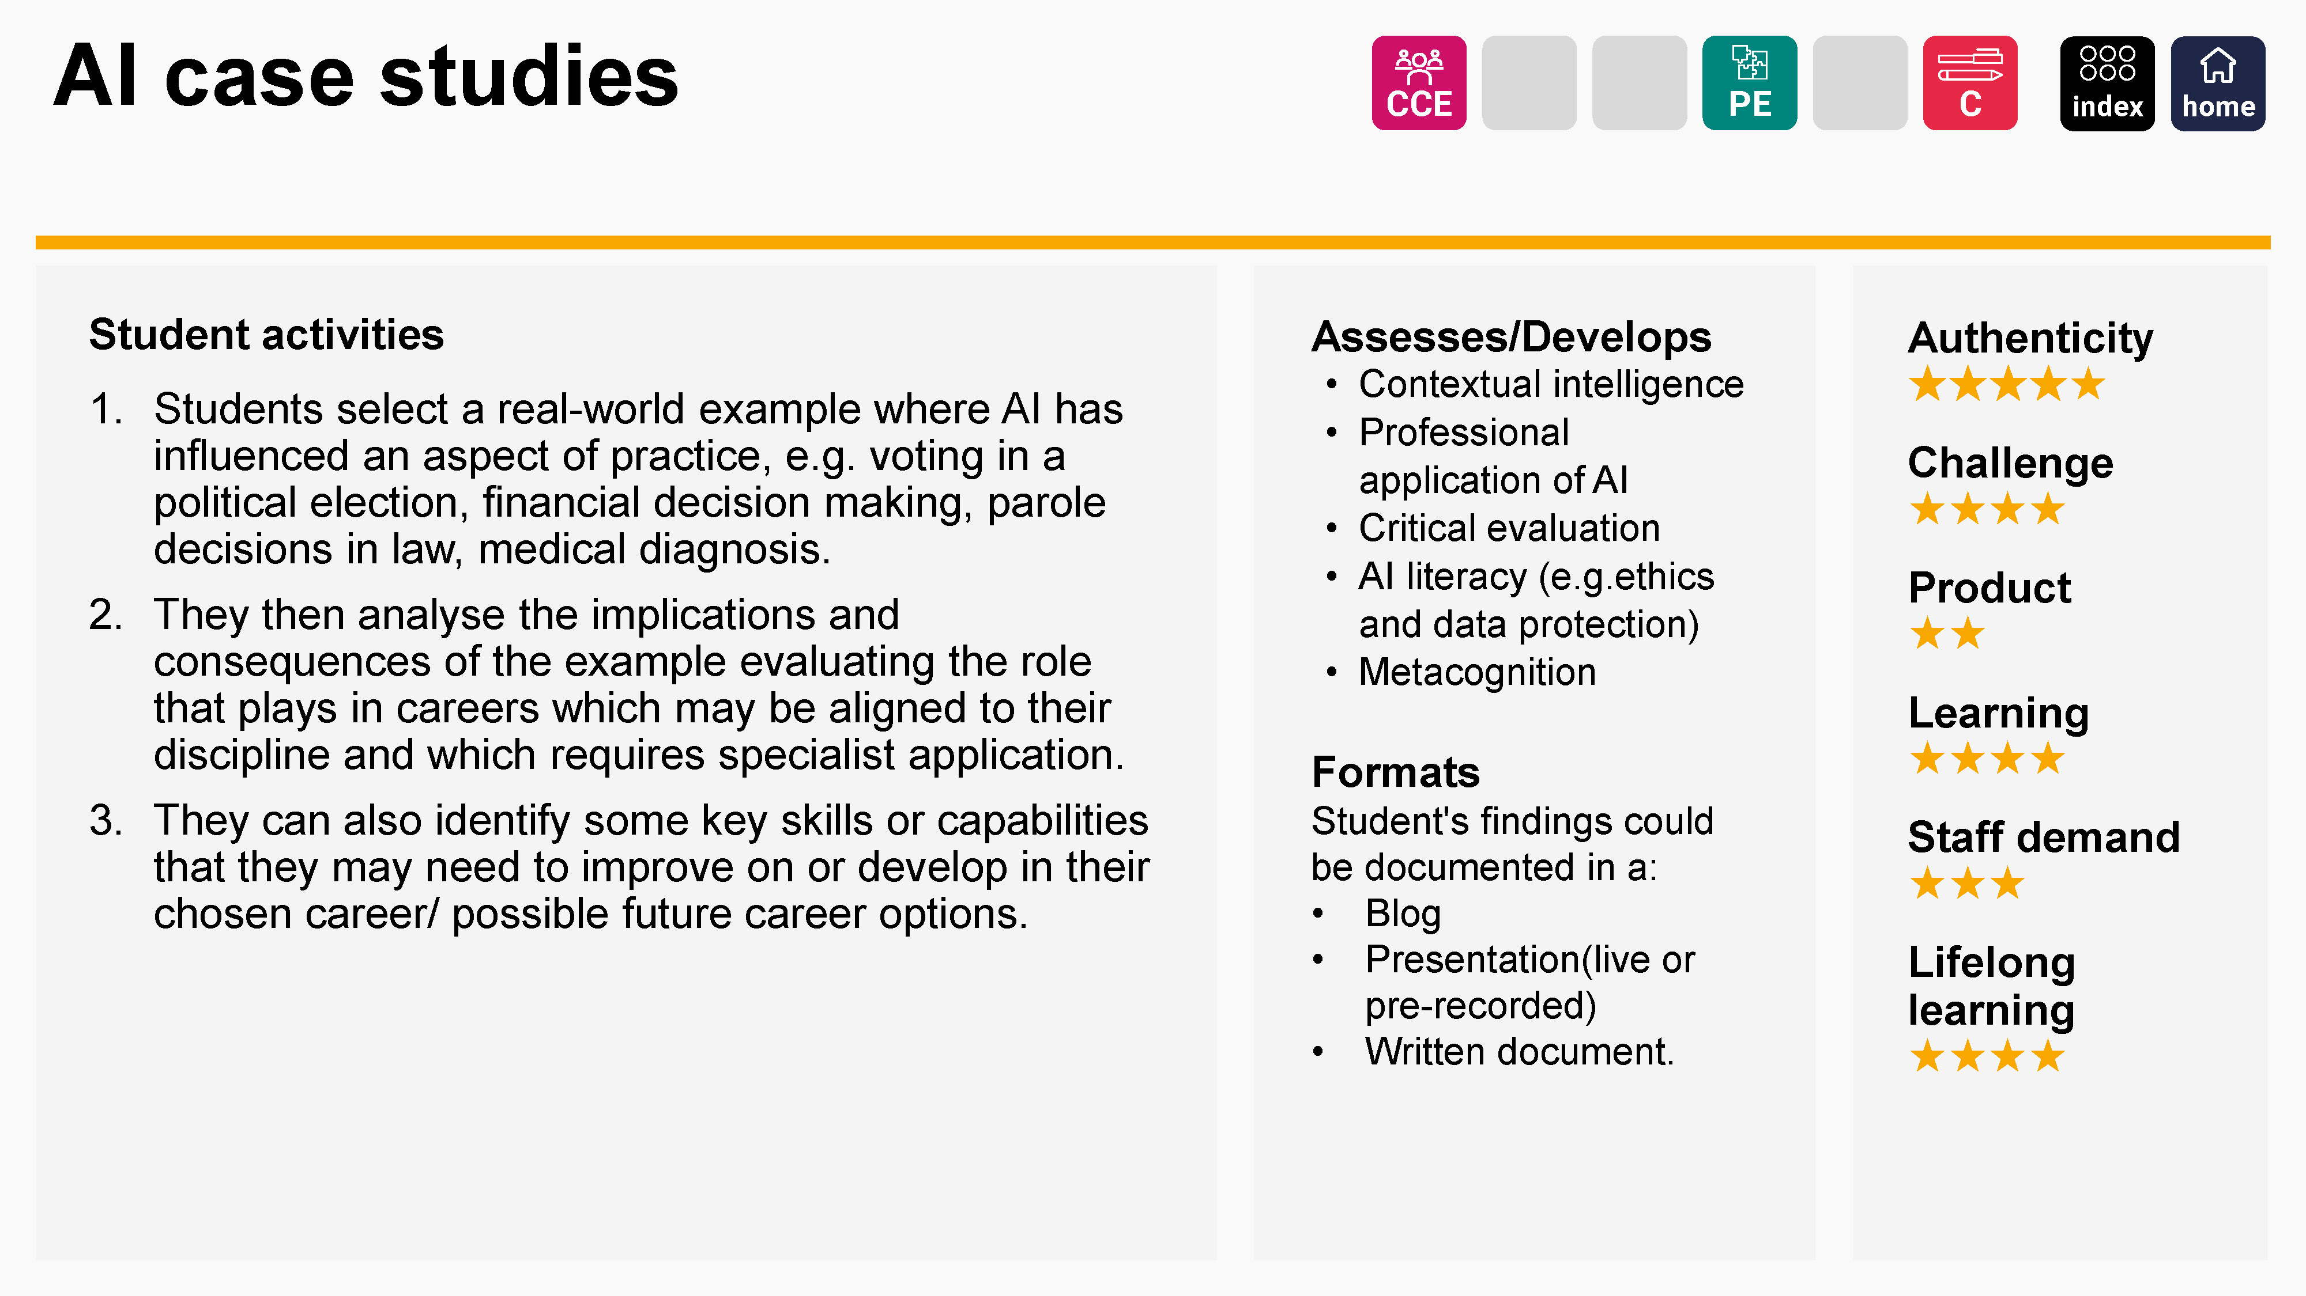
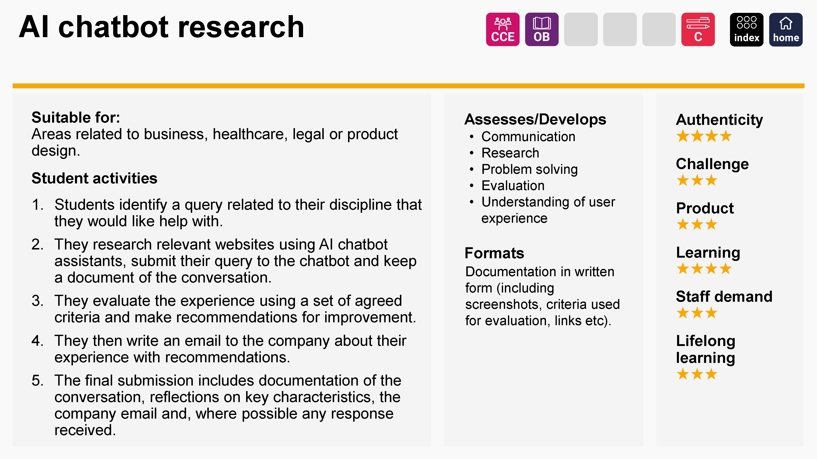
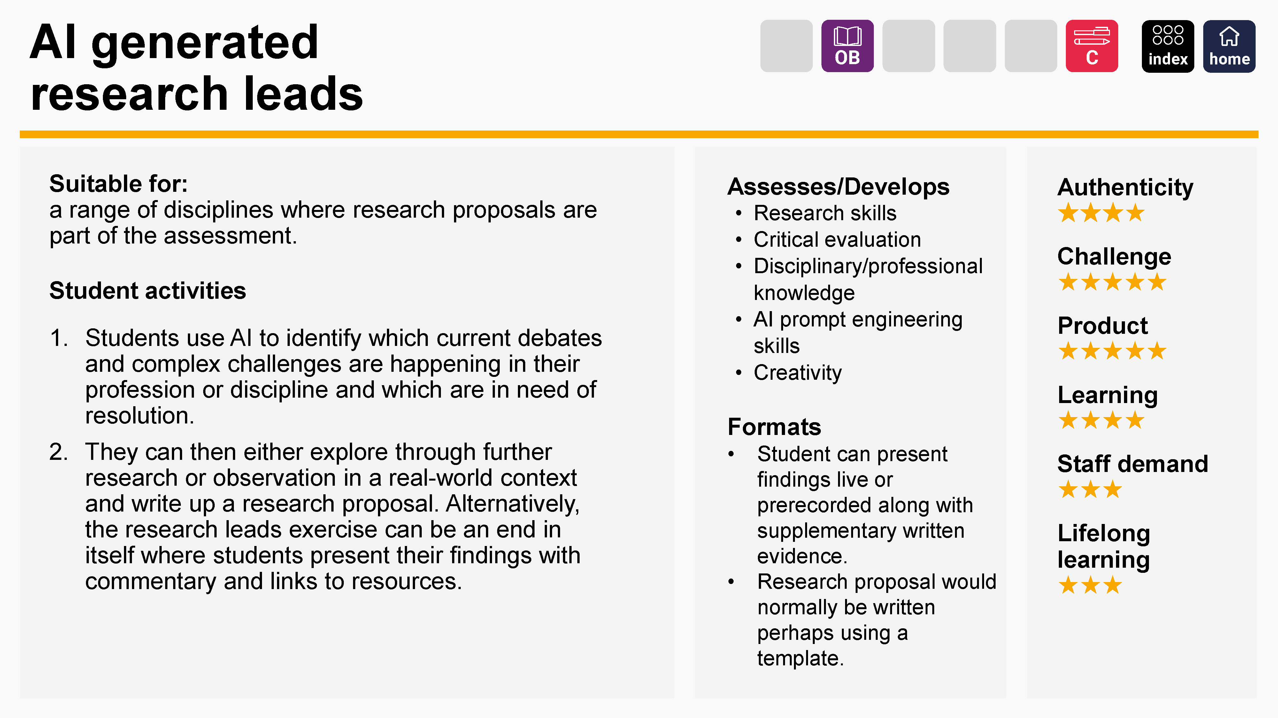
Each card outlines:
Type of assessment task
Corresponding assessment type in UCL's
Assessment Operating Model. See slide 4 for key
The learning that it assesses and develops with
reference to Bloom’s taxonomy, personal and
professional capabilities and AI literacy
Appropriate formats
Rating on some key characteristics of assessment.
See slides 5 and 6 for key
Where appropriate, whether the activity is suitable for specific disciplinary areas

Slide 4






Assessment categories
The cards use six types of summative assessments/exam categories common in HE education, abbreviated as follows:
Controlled Condition Exams (time limited exams – in person or online - which may or may not allow for use of authorised resources).
Practical Exams (practical assessments with a short, fixed duration such as presentations, group presentations, vivas, clinical exams, OSCEs, lab tests etc).
Take-Home Papers / Open Book (assessments with limited duration of say 1 day to 1 week. Students are allowed access to resources).
Dissertation (extended, in-depth coursework assignments involving research and independent study).
Quizzes & In-class Tests (these take place in person or online and although often include MCQ type questions may also include other class activities).
Coursework and other Assessments (Assignments where students are typically given a few weeks to complete the assessment). Includes essays, reports, portfolios, artefacts, exhibitions or other assessment that does not fit into other categories.

Slide 5
Star ratings explained
The star ratings on these cards show one perspective on the characteristics of each assessment type. Users should debate and discuss these judgements and come to their own view.
★★★★★

Slide 6
The ratings relate to key areas of assessment design and priorities:
Authenticity | Often mirroring real life, complex challenges, authentic assessments have diverse outputs and focus on ‘process’ as well as product. They equip students to work with uncertainty and caused them to reflect meaningfully on their learning.
Challenge | The effort required to construct or produce meaning or knowledge rather than simply re-producing meaning and knowledge as created by others.
Product | The outcome enables students to demonstrate learning by engaging in complex performance, creating a significant product or accomplishing a complex task, using higher-order thinking, problem-solving and creativity.
Learning | The level of active learning students engage in during the assessment either through feedback opportunities or metacognition (learning how to learn).
Staff demand | The manageability of different assessments in different circumstances. This could be the support students need in terms of developing certain capabilities such as AI literacy or critical thinking, providing feedback opportunities or in the assessment mechanisms.
Lifelong learning | The possible impact of the assessment beyond the timescale of a programme of study and how it prepares students to meet their present and future learning needs.

Slide 7







Assessment category index
The assessment cards relate to the six categories shown here. Flick through the cards and look for ideas you might try.
Alternatively, click on a category opposite to view an index of relevant cards.
CCE
Controlled Condition Exams​
OB
Take-Home Papers /
Open Book​
Q
Quizzes and
In-class Tests​​
PE
Practical Exams
D
Dissertation
C
Coursework and other Written Assessments

Slide 8

Controlled Condition Exams​
AI case studies »
Explain your thinking »
AI chatbot research »
Infographic »
AI solution finder »
Live analysis »
Analyse public data »
Style and profile »
Case study (provided) »
Visualise a concept »
Debate with AI »
Writing futures (with AI) »
Design a non-AI assessment »

Slide 9

Take-Home Papers /
Open Book​
AI solution finder »
Design a non-AI assessment »
AI think-pair-share »
Explain your thinking »
Annotated bibliography »
Infographic »
Analyse public data »
Live analysis »
AI chatbot research »
Case study (provided) »
Style and profile »
AI generated research leads »
Debate with AI »
Visualise a concept »
AI prompt competition »
Data explainer »
Writing futures (with AI) »

Slide 10

Quizzes and
In-class Tests​​
Analyse public data »
Data explainer »

Slide 11

Practical exams
AI case studies »
Field viva »
AI prompt competition »
Public meeting »
AI road test »
Research translation »
AI think-pair-share »
Simulation »
Annotated bibliography »
Talk like TED »
Case study (student led) »
Triple jump »
Design a quiz »

Slide 12

Dissertation
AI solution finder »
Documentary assignment »
Case study (student led) »
Micro action research project »
Consultant report »

Slide 13
Coursework and other Written Assessments
AI case studies »
Case study (student led) »
Documentary assignment »
Research translation »
AI chatbot research »
Collections »
Field viva »
Style and profile »
AI generated research leads »
Consultant report »
Imaginary objects exhibition »
Talk like TED »
AI prompt competition »
Create a teaching resource »
Infographic »
Triple jump »
AI road test »
Data explainer »
Learning journal/log »
Visualise a concept »
AI solution finder »
Debate with AI »
Live analysis »
Work-based assessment »
AI think-pair-share »
Design a quiz »
Micro action research project »
Work-in-progress exhibition »
Analyse public data »
Design and build »
On campus project »
Writing futures (with AI) »
Annotated bibliography »
Design a non-AI assessment »
Patchwork assessment »
Case study (provided) »
Digital field guide »
Public meeting »

Slide 14



AI case studies
Student activities
Students select a real-world example where AI has influenced an aspect of practice, eg voting in a political election, financial decision making, parole decisions in law, medical diagnosis.
They then analyse the implications and consequences of the example evaluating the role that plays in careers which may be aligned to their discipline and which requires specialist application.
They can also identify some key skills or capabilities that they may need to improve on or develop in their chosen career/ possible future career options.
Assesses/Develops
Contextual intelligence
Professional application of AI
Critical evaluation
AI literacy (e.g.ethics and data protection)
Metacognition
Formats
Student's findings could be documented in a:
Blog
Presentation(live or pre-recorded)
Written document.
Authenticity
★★★★★
Challenge
★★★★
Product
★★
Learning
★★★★
Staff demand
★★★
Lifelong learning
★★★★

Slide 15

AI chatbot research
Suitable for:
Areas related to business, healthcare, legal or product design.
Student activities
Students identify a query related to their discipline that they would like help with.
They research relevant websites using AI chatbot assistants, submit their query to the chatbot and keep a document of the conversation.
They evaluate the experience using a set of agreed criteria and make recommendations for improvement.
They then write an email to the company about their experience with recommendations.
The final submission includes documentation of the conversation, reflections on key characteristics, the company email and, where possible any response received.
Assesses/Develops
Communication
Research
Problem solving
Evaluation
Understanding of user experience
Formats
Documentation in written form (including screenshots, criteria used for evaluation, links etc).
Authenticity
★★★★
Challenge
★★★
Product
★★★
Learning
★★★★
Staff demand
★★★
Lifelong learning
★★★

Slide 16

AI generated research leads
Suitable for:
a range of disciplines where research proposals are part of the assessment.
Student activities
Students use AI to identify which current debates and complex challenges are happening in their profession or discipline and which are in need of resolution.
They can then either explore through further research or observation in a real-world context and write up a research proposal. Alternatively, the research leads exercise can be an end in itself where students present their findings with commentary and links to resources.
Assesses/Develops
Research skills
Critical evaluation
Disciplinary/professional
knowledge
AI prompt engineering skills
Creativity
Formats
Student can present findings live or prerecorded along with supplementary written evidence.
Research proposal would normally be written perhaps using a template.
Authenticity
★★★★
Challenge
★★★★★
Product
★★★★★
Learning
★★★★
Staff demand
★★★
Lifelong learning
★★★

Slide 17
AI prompt competition
Student activities
Identify a major question/challenge in your discipline, preferably with no clear solution.
Collaborate on developing and agreeing 5 to 10 criteria for assessing AI generated responses to the question, e.g. does it reference more than one theoretical perspective?
Individually write a prompt for AI to answer the question.
In small groups use their criteria to judge the responses of other students and rate the AI prompts/responses from best to worst.
Write up a report/reflection on the process.
Assesses/Develops
Critical evaluation
Problem solving
AI literacy
(e.g. prompt engineering)
Reflection
Collaboration
Formats
Online forums or in-class activities
(step 1 to 3).
Written document or presentation as live /recorded oral, PPT or video.
(steps 4 to 5).
Authenticity
★★★★
Challenge
★★★★
Product
★★★
Learning
★★★★
Staff demand
★★★
Lifelong learning
★★★

Slide 18
AI road test
Student activities
The student uses AI to generate a short (200 word) response to an open question.
They individually complete a pro forma which includes elements in the AI-generated answer such as quality of writing (language, references, argument etc.).
In small groups students discuss their findings.
They then give a joint presentation on the process and outcomes of their discussions.
They might also be asked to individually or collaboratively write a better written piece.
Assesses/Develops
Critical thinking
Group work
Good academic writing practice in referencing and summarising
Formats
The conversation and presentation can be in class or online.
The presentation could also be a pre-recorded video (e.g., using PPT).
Authenticity
★★★★
Challenge
★★★★
Product
★★
Learning
★★★★
Staff demand
★★
Lifelong learning
★★★

Slide 19
AI solution finder
Suitable for:
a range of disciplines but could be of particular use post placement where students have had experience of real-world, work-based challenges.
Student activities
Students appraise current challenges in a specific professional or disciplinary field and investigate where AI could offer opportunities OR identify a challenge themselves (new or predicted).
They then present rationale for selection of the challenge (why it is a priority) and a plan for how AI might help to resolve it.
They could then present this to work-based colleagues/managers for feedback where relevant.
Assesses/Develops
Creativity and divergent thinking
Contextual intelligence
AI literacy
AI technical understanding
Research
Professional confidence
Formats
Presentation (live or prerecorded).
Written document.
Blog post.
Authenticity
★★★★★
Challenge
★★★★
Product
★★★★★
Learning
★★★★
Staff demand
★★★
Lifelong learning
★★★★

Slide 20
AI think-pair-share
Student activities
Students individually identify a key challenge in their field or discipline.
Using three different types of prompts, they generate a response from an AI text generator.
They pair up to exchange notes on the process and whether the outputs were correct, surprising etc.
Individually, they then refine their prompt to generate a final AI output and log the changes they make.
They submit this output along with their prompt, improved AI response, added content highlighted and a reflection about the pre-work in pairs.
Assesses/Develops
Critical thinking
Evaluation
AI literacy
Independent thinking
Reflection
Formats
In class or Teams.
Output will be in written format.
Students can use Track
Changes in MS Word or Suggesting in Google Docs to make and log changes.
Authenticity
★★★★
Challenge
★★★★
Product
★★★
Learning
★★★★
Staff demand
★★★
Lifelong learning
★★★

Slide 21
Analyse public data
Student activities
Students locate open-source live data sets (e.g. from sources such as Google Trends, WHO, Earth Data and governments) to help answer current pressing questions associated with their discipline (that they have either identified or been provided with). For arts subjects this could mean exploring open access repositories.
Using a set of criteria they evaluate the data from a user perspective.
They could also select and work with data to generate an output such as policy proposal, infographic or documentary.
Assesses/Develops
Cultural intelligence
Evaluation
Data literacy
Application
Research skills
Ethical and contextual understanding.
Formats
For testing this could be a Quiz delivered online or in class.
For evaluation this could be a proforma or report.
Output could be produced in written, visual, or video formats.
Authenticity
★★★★
Challenge
★★★★
Product
★★★
Learning
★★★★★
Staff demand
★★★
Lifelong learning
★★★

Slide 22
Annotated bibliography
Student activities
The students compile a list of sources (written/other media), including a diverse range of authors, e.g. from different cultural, racial or class backgrounds who identify as LGBTQ, disabled or other characteristics.
They summarise their choice of material, providing a brief explanation of its application to their area of study.
For at least 2 entries they provide a more in-depth discussion /critique of the material and why they think it is an important addition to the curriculum.
Lists are shared with peers and each student commits to following up on at least one source from another’s list.
Each student submits their annotated list with commentary about their learning throughout the process
Assesses/Develops
Cultural intelligence
Evaluation
Analysis
Understanding
Critical reflection
Self-evaluation
Information literacy
Formats
Online reference tools e.g. Moodle Glossary, Talis Elevate, Zotero for formative.
For summative, a document or presentation (live or recorded).
Authenticity
★★★
Challenge
★★★
Product
★★
Learning
★★★★
Staff demand
★★★
Lifelong learning
★★

Slide 23
Case study (provided)
Student activities
Students are provided with an existing case study or multiple ones with similar features.
They are asked to read thoroughly, take notes and highlight key areas included in the case studies.
They then identify 2 to 3 key problems, why they exist, how they impacted the organisation/s, who is responsible and whether they think the solutions offered are viable (and if not why not).
Students then present their findings including a reflection on what professional or theoretical models they think are useful in interpreting these case studies.
Assesses/Develops
Analysis
Application
Critical evaluation
Relating theory to practice
Understanding of
professional contexts
Formats
Written document.
In-class or online
presentation (PPT for example).
Video submission of
pre-recorded piece.
Authenticity
★★★★
Challenge
★★★★
Product
★★★
Learning
★★★★
Staff demand
★★
Lifelong learning
★★★

Slide 24
Case study (student led)
Student activities
Students identify a real-life issue or challenge in their discipline or professional context or organization.
In groups, students discuss their issues, possible explanations, data and any solutions they are thinking about.
Depending on the level of the student EITHER:
  based on group discussion, produce a draft proposal for a research-informed case study (what data is needed, which stakeholders, analysis methodology, hypothetical solutions etc) for presentation to the class OR
  conduct small-scale research by gathering data/interviews, analysis and producing a report and recommendations for presentation to stakeholders.
Assesses/Develops
Analysis
Application
Critical evaluation
Relating theory to practice
Understanding of
professional contexts
Formats
In-person or online
presentation.
Authenticity
★★★★
Challenge
★★★★
Product
★★★
Learning
★★★★
Staff demand
★★
Lifelong learning
★★★

Slide 25
Collections
Student activities
Students select and organise information for a given context (e.g. music, or film performances for a festival, poems for a publication, equipment for a new veterinary practice, products for a new fashion retail website) and provide a critical narrative to explain their choices for inclusion or exclusion of material.
Feedback can be sought at various stages of the process through group discussion or one-to-ones.
The next step could be to ask students to produce or stage the final event, publication, website or exhibition OR to make it more manageable for large cohorts, ask them to produce a mixed media output with supporting documentation.
Assesses/Develops
Critical evaluation
Contextual intelligence
Organisation
Creativity
Planning
Formats
Depends on the student’s project and area of interest.
Final submissions for assessment could be made in written form with links/images and documentation.
Authenticity
★★★★
Challenge
★★★★
Product
★★★★★
Learning
★★★★★
Staff demand
★★★
Lifelong learning
★★★

Slide 26
Consultant report: professional futures
Student activities
Students explore the role of AI in their discipline or professional areas.
Students research or imagine how AI may influence their future career, eg through news articles, speaking to others, looking at webinars on the subject.
You may want to develop the task by inviting in guest speakers and providing opportunities for Q&A. Students can also contribute to discussion forums or work collaboratively.
Students can then individually/ in group produce a consultant report for a professional body. They might also create an action plan evaluating their current strengths and areas for development in terms of AI /technical skills.
Assesses
Contextual intelligence
Research
Presentation and communication skills
Synthesis of ideas
Professional skills and knowledge
Formats
Webpage.
Blog.
Video.
Podcast.
Written document.
Authenticity
★★★★
Challenge
★★★★
Product
★★★★★
Learning
★★★★
Staff demand
★★★
Lifelong learning
★★★★

Slide 27
Create a teaching resource
Student activities
Students are asked to create a collaborative resource to teach other students (present or future) about a specific topic e.g. to explain key concepts or identify common misconceptions
As a group they agree on a chosen medium or platform and what topic/aspect of a topic each individual will cover.
Group reviews and revises final resources.
Once completed students are assessed both on group collaboration and individual contribution.
Remember to ask students for permission to use their work with future cohorts.
Assesses/Develops
Metacognition
Collaboration
Communication
Grasp of subject knowledge
Assessment literacy
Digital skills
Formats
Blog, video or interactive resource.
Written document depending on what students agree.
Authenticity
★★★
Challenge
★★★★
Product
★★★★
Learning
★★★★★
Staff demand
★★
Lifelong learning
★★★★

Slide 28
Data explainer
Student activities
Students are directed to a data set, e.g. business accounts or product testing measurements, and asked to perform appropriate calculations and interrogation.
They could compare calculations done on specialist data sets with those obtained from generative AI.
They then describe the steps that they went through as if explaining to a client, patient or colleague.
They are asked to draw conclusions and make recommendations. They might use data visualisations to summarise findings.
Assesses/Develops
Understanding (deep knowledge)
Data Analytics
Evaluation
Communication
Metacognition
Formats
Could use online quiz for Step 1 and 2.
Documentation and final output could be written, presentation (live, prerecorded) or video.
Authenticity
★★★★
Challenge
★★★
Product
★★★★
Learning
★★★★
Staff demand
★★★
Lifelong learning
★★★

Slide 29
Debate with AI
Student activities
Students choose (or are provided with) a major question or challenge in their field or discipline.
Either as an individual or group activity, they present this to an AI text generator) and engage in a debate with AI by questioning the responses (you may have to provide some guidance around questioning strategies).
The students then individually produce an argumentative essay based on their dialogue with AI – evaluating both their own position and that of AI.
Assesses/Develops
Critical evaluation
Problem solving
AI literacy
Independent thinking
Contextual intelligence
Formats
AI text generator e.g., ChatGPT.
Group debate in class, online (via webconference or online forum).
Essay could be written, video or audio.
Authenticity
★★★
Challenge
★★★★
Product
★★★
Learning
★★★★★
Staff demand
★★★
Lifelong learning
★★★

Slide 30
Design a quiz
Suitable for:
disciplines where students undertake calculations, e.g. engineering or accounting.
Student activities
Before starting, tutors will need to discuss question design with students – what 'good distractors' (i.e. wrong answers) look like and how to avoid ‘giveaways.’
Students individually research question material, answers and feedback they will provide. They might use AI to generate some initial ideas but will have to interrogate responses.
They then share with others for peer review and revise where necessary.
After quality checking /assessment, quizzes can be used by future cohorts for formative assessment.
Assesses/Develops
Foundational knowledge
Research
Evaluation
Metacognition
Collaboration
Formats
This could be provided as word document or a collaborative interactive quiz (if IT permissions allow).
Authenticity
★★★
Challenge
★★★★
Product
★★★
Learning
★★★★
Staff demand
★★
Lifelong learning
★★

Slide 31
Design and build
Student activities
Students design a product that addresses a real-life problem, e.g. practical solution for engineering or computing, a professional development template for a business student.
Once a draft is prepared they present to peers and/or stakeholders for feedback.
Students can use AI for brainstorming ideas, refining presentations, checking calculations, seeking advice on component selection etc.
They produce a reflective narrative (or exhibition) to accompany their product, documenting the design process, decisions made, team-work and relevant stakeholder engagement.
Realistic management of scope of brief and available resources is essential.
Assesses/Develops
Metacognition
Research
Social intelligence
Application
Practical competence
Assessment literacy
Collaboration
Formats
Depends on the nature of the project. Final submission can be:
Portfolio.
Blog.
Written document
Presentation (live or recorded).
Authenticity
★★★★★
Challenge
★★★★★
Product
★★★★★
Learning
★★★★★
Staff demand
★★★★★
Lifelong learning
★★★★★

Slide 32
Design a non-AI assessment
Student activities
Students use an AI text generator to answer an essay question about a major question or challenge in their field or discipline.
In groups or individually they write down five things they learned about the topic from the AI text generator and reflect on what they learned from this software and/or what they didn’t learn.
Students then design a new assignment that doesn’t allow for the use of AI but that allows them (or other students) to demonstrate their learning.
Assesses/Develops
Critical evaluation
Problem solving
Groupwork
AI literacy
Formats
AI text generator, e.g. ChatGPT.
Group discussion in class, online or asynchronously via an online forum.
Final output could be written, video or audio submission.
Authenticity
★★★★
Challenge
★★★★
Product
★★★★
Learning
★★★★
Staff demand
★★★
Lifelong learning
★★★

Slide 33
Digital field guide
Student activities
Students use digital sources of information to create virtual field guides about specific sites (natural world, archaeology, heritage, architecture, geology etc). If using AI sources, these need to be evaluated for accuracy, bias and so on.
Using a range of media, students collate an in-depth description or analysis of particular species, landscape feature or place. Subject can be chosen by students or allocated.
This can be undertaken individually or as a group.
Completed guide is published online with QR codes to enable users to use the field guide to enhance their engagement with the environment.
Assesses/Develops
Critical evaluation
Social and cultural intelligence
Digital literacy
(including AI)
Subject knowledge
Collaboration
Communication
Formats
Blog.
Website.
Downloadable PDF.
Authenticity
★★★★
Challenge
★★★★
Product
★★★★★
Learning
★★★★★
Staff demand
★★★
Lifelong learning
★★★

Slide 34
Documentary assignment
Student activities
Students use the documentary format to consider aspects of programme material and investigate issues. This can be a simple thought piece or a more complex production (e.g. production team of students, interviews with participants, field work etc).
They research different documentary styles and identify one to work with, what medium and style to use (audio, video, animation, live action etc) and, if working in groups, identify roles, plan and execute their piece.
NB: The brief needs to be clear about whether the documentary should take a clear personal position or be more impartial. Also, clarity on stages of production, length of piece and assessment criteria is required (e.g. what is prioritised — production quality, presentation, content, group work etc).
Assesses/Develops
Research
Communication
Technical production skills (where relevant)
Creativity
Critical thinking
Independent thinking
Collaboration (where relevant)
Planning and organisation
Formats
Video.
Audio.
Recorded animation or screencast.
Authenticity
★★★★★
Challenge
★★★★★
Product
★★★★★
Learning
★★★★
Staff demand
★★★★
Lifelong learning
★★★

Slide 35

Explain your thinking
Student activities
Provide assignment as usual, but in addition require that students to explain at least 8 to 10 steps of their thinking.
For example, students can describe the steps in their logic, their problem solving or writing process, or the development of their theoretical path.
Assesses/Develops
Reflection
Problem solving
Communication
Research
Metacognition
Digital skills
Formats
Written document using Track Changes in MS Word or Suggesting in Google Docs.
Audio or video recording (as interview or talking head).
Authenticity
★★★★
Challenge
★★★★
Product
★★★
Learning
★★★★
Staff demand
★★★
Lifelong learning
★★★★

Slide 36
Field viva
Suitable for:
practice-based disciplines
Student activities
Students undertake a professional discussion whilst located in an outdoor practice situation (agronomist talking to a farmer, a surveyor talking to a utilities company or environmental scientist talking with a landowner).
The student will research discussion partner and arrange meeting in situ.
The live environment should add value to the situation rather than being just a backdrop.
Student documents meeting with photos and debrief of the experience.
They will have to seek participants permission for recording and potential help from peers if using video.
Assesses/Develops
Social intelligence
Emotional intelligence
Research
Applied knowledge
Interviewing skills
Understanding of professional context
Formats
Blog or portfolio would be suitable to host multimedia submissions (video, audio, text, images).
Alternatively, submission could be video with documentation.
Authenticity
★★★★★
Challenge
★★★★
Product
★★★★★
Learning
★★★★★
Staff demand
★★★★
Lifelong learning
★★★

Slide 37
Imaginary objects exhibition
Suitable for:
architecture, design or art contexts.
Student activities
Ask students to identify an object, building or product that they would like to design (one that does not currently exist).
Students generate cross-section drawings of the imaginary object using permitted AI image generators.
They then translate this into three dimensions for an exhibition.
In a seminar they discuss the objects with peers.
They need to document the process throughout and finally submit this, a summary of the seminar discussion and their own conclusions about the product.
Assesses/Develops
Creativity
Critical evaluation
AI literacy
Practical competence
Contextual intelligence
Formats
Exhibition could be physical or online portfolio for display. To document students could use:
Portfolio (also allows feedback from others).
Blog with documentation and reflections.
Audio/video recording plus written documentation.
Authenticity
★★★★★
Challenge
★★★★★
Product
★★★★★
Learning
★★★★★
Staff demand
★★★★★
Lifelong learning
★★★★
Notes:
Again – consistency of “Suitable”; period after “images”

Slide 38
Infographic
Student activities
Students are asked to create an infographic in relation to a specific theme or a topic, selecting and presenting data by making a series of design choices.
You may have to advise students on free, accessible software they can use to produce this. The infographic does not have to be professional standard; the focus is on the design and flow of information.
As a supplement to the infographic students also produce a narrative to explain how they made the decisions about what to include and exclude, and how to combine data sets.
Assesses/Develops
Data literacy
Communication
Synthesis of complex information
Presentation skills
Data visualisation
Digital design skills
Formats
Infographic could be presented in image or live PPT presentation.
Supporting documentation either written, audio or video.
Authenticity
★★★
Challenge
★★★
Product
★★★
Learning
★★★★
Staff demand
★★
Lifelong learning
★★★

Slide 39
Learning journal/log
Student activities
Students document learning, highlighting events such as critical incidents, analyse their own goals and progress against these, and to discuss their values. This activity could translate to sketch books for arts-based disciplines.
Students may have to be supported in understanding what reflection means within a disciplinary area. Exemplars may be useful.
For assessment a pass/fail rather than a numerical grade can help signal the intrinsic value of this activity. Allow students to select what they want to have marked (e.g. choose three entries) while requiring the whole journal to be shared to demonstrate sustained, commitment to the learning process.
Assesses/Develops
Critical reflection
Metacognition
Procedural/practical knowledge
Contextual intelligence
Formats
Submissions could include drawings, text, video, audio diaries or multi-media. Journals could use:
Portfolio.
Blog.
Industry provided/bespoke e.g. medicine may use specific competency-based software.
Authenticity
★★★★
Challenge
★★★
Product
★★★★★
Learning
★★★★★
Staff demand
★★
Lifelong learning
★★★★

Slide 40
Live analysis
Student activities
Students are presented with live information e.g. on live political situations, current debates, media moments, or cultural events.
They produce an analysis of the causes, lessons, trends, and interventions.
They can provide this in a way that is discipline specific e.g. ‘long-read’ news publication, press release, scientific ‘viewpoint’ article or other analysis rich text.
Assesses/Develops
Critical analysis
Divergent thinking
Subject knowledge
Contextual knowledge
Communication
Managing uncertainty
Formats
Written document
Blog.
Presentation (live or pre-recorded).
Authenticity
★★★★★
Challenge
★★★★★
Product
★★★★
Learning
★★★★★
Staff demand
★★★
Lifelong learning
★★★

Slide 41
Micro action research project
Student activities
Students choose an issue or organisational challenge they would like to address.
They identify relevant literature/research to inform their approach, which stakeholders they will work with, the timeline, evaluation methods and what support they will need.
With key stakeholders they design an organisational improvement project, identifying and implementing one small scale intervention they believe will have a positive impact.
They present findings to the organisation in question, complete a report and submit this with feedback from the organisation and supporting documentation for their assessment.
Assesses/Develops
Research
Problem solving
Collaboration
Evaluation
Links between theory and practice
Ethical mindset
Project/change management
Formats
For final submission:
Blog
Portfolio
Video/oral presentation
Written report.
Authenticity
★★★★★
Challenge
★★★★★
Product
★★★★★
Learning
★★★★★
Staff demand
★★★★
Lifelong learning
★★★★

Slide 42
On campus project
Student activities
Students work in groups on campus-based projects which can encompass social, environmental, educational, or economic issues.
Students identify a broad areas of focus and campus-based teams (clients) to work with, e.g. estates, catering, or laboratories.
Student teams liaise with appropriate stakeholders (mediated by staff if required) to discuss issues.
They then work together to produce client briefings, proposed solutions.
They ask client for feedback and if agreed, client may take up proposal in part or in full.
Assesses/Develops
Divergent thinking
Planning
Social intelligence
Communication
Collaboration
Contextual intelligence
Cultural intelligence
Formats
Portfolio of documentation and
commentary.
Blog for documenting process and communicating with wider community.
Authenticity
★★★★★
Challenge
★★★★
Product
★★★★★
Learning
★★★★★
Staff demand
★★★★★
Lifelong learning
★★★★

Slide 43
Patchwork assessment
Student activities
Students are given a task, e.g. to write a policy review of food security reform within a global setting or curate an exhibition on a topic covered in their programme.
They choose their topic by week three of the module.
Early in module, they submit/present short drafts (guidance provided on what this should contain) for feedback from staff and students. AI can be used to generate ideas which can be interrogated, revised and integrated if useful.
They receive three pieces of feedback on parts of draft (patches).
They submit/present a final draft but do not receive feedback on sections they had a chance to submit and get feedback on earlier in the module.
Assesses/Develops
Research
Planning
Professional skills
Evaluation
Problem solving
Competence in key skills
AI literacy
Formats
For steps 1 to 4 online forums, in person, pre-recorded presentations cam be used as well as written documentation of process.
Final submission depends on task but could include online portfolio, physical exhibition, video, website or written document.
Authenticity
★★★★★
Challenge
★★★★★
Product
★★★★
Learning
★★★★★
Staff demand
★★★★
Lifelong learning
★★★★

Slide 44
Public meeting
Student activities
Students research a controversial issue which has implications for communities (e.g. new housing development, medical treatment or a new way of voting in local elections).
They then undertake research and compile a 15-minute presentation for a public meeting, using evidence-based arguments and ensuring that complex issues are communicated in a way that is accessible.
They present to the class. The class assumes the role of the affected community. The student responds to their questions.
Assesses/Develops
Research
Communication
Social intelligence
Problem solving
Public speaking
Empathy
Formats
Presentations could be with live in person or online with audience or pre-recorded with questions submitted asynchronously.
Authenticity
★★★★★
Challenge
★★★★★
Product
★★★★
Learning
★★★★★
Staff demand
★★★
Lifelong learning
★★★

Slide 45
Research translation
Student activities
Students work with researchers to understand how knowledge in their discipline is produced.
Ask PhD students to come and share their research in classes; allow and encourage students to generate questions.
Students then ‘interpret’ the research with some simplified outputs, e.g. posters, infographics, technical notes or a few slides. This can be done as a group exercise or as an individual depending on group size. Students may translate one piece of work or choose multiple ideas to represent.
Assesses/Develops
Synthesis of complex ideas
Analysis
Communication
Collaboration
(if groupwork)
Metacognition
Understanding of research process
Knowledge production
Formats
Outputs can be produced using simple, available software (Word, PPT, Canva etc).
Authenticity
★★★★★
Challenge
★★★★
Product
★★★★
Learning
★★★★★
Staff demand
★★★
Lifelong learning
★★★★

Slide 46
Simulation
Student activities
Simulations involve scenarios presented to students in situations which are designed to be very much like the real professional environment e.g law clinic, conference room for a parliament or international convention or clinical situation.
Students are asked to perform tasks or participate in the situation.
This can be done through simple role play style approaches or fully immersive and highly equipped facilities (such as clinical settings). Digital or VR simulations may be available in some disciplines.
These would normally be assessed in situ or, if recorded, via playback.
Assesses/Develops
Metacognition
Social intelligence
Adaptability
Applied knowledge
Practical competence
Resilience
Formats
The context would determine the mode of delivery. Students could be asked to submit reflections on learning from the simulation (written, audio, video).
Authenticity
★★★★★
Challenge
★★★★★
Product
★★★★★
Learning
★★★★★
Staff demand
★★★★
Lifelong learning
★★★★

Slide 47
Style and profile
Suitable for:
disciplines such as creative writing, art, design, film where style signatures are key.
Student activities
Students use AI to generate a range of outputs in different genres or styles.
They then consider which aspects of the output are true to the original and where it differs or misrepresents original and in what way ,e.g. sentence formation, word selection, punctuation and grammar, etc.
Students document their thinking.
Another application may be to ask students to produce work ‘in the style of’ then compare with the AI output (as well as the original).
Assesses/Develops
Critical evaluation
Understanding of creative practice and genres
Analysis
AI literacy
Individual creative practice
Formats
A range of AI tools could be used depending on purpose. The output could be:
Live or recorded video.
Written document.
Blog post.
Authenticity
★★★★
Challenge
★★★★
Product
★★
Learning
★★★★
Staff demand
★★★
Lifelong learning
★★★

Slide 48
Talk like TED
Student activities
Students do a talk as if to a live audience along the lines of a Ted talk on topic of their choosing.
Students discuss idea with tutor and then start to script their talk. This should have a narrative and ideally personal focus and aim to engage a non-specialist audience.
This could be done as live event (in person or online) with several students presenting. Pre-recorded material (e.g. talking head or voice over slides dents who are not comfortable in front of live camera.
Students should be available to answer questions from audience (usually peer group).
Assesses/Develops
Creativity
Narrative structure
Presentation skills
Subject knowledge
Social intelligence
Critical reflection
Metacognition
Formats
Live/ pre-recorded talk via webconference or recorded in- person event.
Video of talk can be submitted with documentation reflecting on experience.
Authenticity
★★★
Challenge
★★★★★
Product
★★★★
Learning
★★★★★
Staff demand
★★★★
Lifelong learning
★★

Slide 49
Triple jump
Suitable for:
clinical settings but also disciplines such as law, surveying, architecture, human resources.
Student activities
Students are presented with an open problem from within a professional area which has multiple possible ways forward rather than a single answer. The problem is often framed through a role play approach e.g. ‘mock clinic’ or simulation with students in role of client or patient.
The student meets with their ‘client/ patient’ to establish the situation and ask any clarifying questions.
They research the issue using appropriate resources (2 to 3 hours).
They then return to ‘client /patient’ and present recommendations.
‘Client/patient’ feeds back on usefulness of process.
Assesses/Develops
Divergent thinking
Emotional intelligence
Communication
Research
Contextual intelligence
Formats
Process could be documented via video (for live in person or online activity).
Authenticity
★★★★
Challenge
★★★★★
Product
★★★★
Learning
★★★★
Staff demand
★★★★★
Lifelong learning
★★★

Slide 50
Visualise a concept
Student activities
Students select a term or concept to represent visually. They then write words describing this and generate an AI-generated image from appropriate software.
They then write a five-minute essay describing the image and linking it to the original term/concept.
Students then adapt their image prompts for the AI image generator to create an improved image reflecting their understanding of the term/concept.
Students present or submit their images and short reflective pieces.
Assesses/Develops
Conceptual understanding
AI prompt engineering
Evaluation
Reflection
Communication
Writing skills
Formats
Live or pre-recorded presentation.
Blog.
Document with image embedded.
Authenticity
★★★
Challenge
★★★★
Product
★★
Learning
★★★★
Staff demand
★★
Lifelong learning
★★★

Slide 51
Work-based assessment
Student activities
This assessment is carried out over a period of time and may include a range of work-based tasks relevant to professional context.
Students are provided with framework to enable them to record, reflect and report on workplace learning and to relate this to the learning they do in class.
The student can also be tasked with liaising between workplace and institution where appropriate and working with both to ensure channels of communication are maintained and that access to relevant documentation is provided to all concerned. The degree of responsibility will depend on the level of the student.
NB: There needs to be clear communication of expectation, criteria and standards between student, workplace mentors and academic staff.
Assesses/Develops
Contextual understanding
Practical application
Professional competence
Understanding of relation between practice and theory
Formats
A portfolio would be the most suitable format as it can accommodate a range of materials (written, audio/video, images and feedback from employers).
Authenticity
★★★★★
Challenge
★★★★★
Product
★★★★★
Learning
★★★★★
Staff demand
★★★★★
Lifelong learning
★★★★★

Slide 52
Work-in-progress exhibition
Student activities
Students create a product or artefact (e.g. vegan food product, musical ident, interior design model, vehicle component prototype).
They exhibit the product along with the story of its development in a cohort wide event (face-to-face or online).
Professionals in the field, along with some willing past students, are invited to see the exhibition and offer constructive feedback.
The feedback is considered and the product refined before submission.
Students can be marked on the product and their reflection on the process, including their use of feedback.
Assesses/Develops
Creativity
Presentation
Procedural capabilities
Metacognition
Communication
Formats
Depending on artefact and nature of exhibition, this could include:
Physical or digital objects.
Portfolio or blog with documentation and reflections on process.
Presentation on exhibition (live/ pre-recorded audio or video).
Authenticity
★★★★★
Challenge
★★★★★
Product
★★★★★
Learning
★★★★★
Staff demand
★★★★★
Lifelong learning
★★★★

Slide 53
Writing futures (with AI)
Student activities
Students are asked to read a range of articles or fiction produced by AI and/or about AI.
Then ask them to produce their own speculative piece – either as a short story or hypothetical piece written by a future self-reflecting on both the positive and negative futures of AI enabled writing.
Assesses/Develops
Creativity
Critical evaluation
AI literacy
Professional
perspective
Writing skills
Formats
Written form.
Presentation (live, pre-recorded).
Podcast.
Video.
Authenticity
★★★★★
Challenge
★★★★★
Product
★★★★★
Learning
★★★★★
Staff demand
★★★★★
Lifelong learning
★★★★

Slide 54
Sources
Content for these cards has been drawn from range of sources, customised or AI-ed where relevant
Lydia Arnold’s Top Trumps
Lydia Arnold: Striking a Balance: Integrating AI into Assessment Practices
Maha Bali, John Parkin, Chris Lott in Creative ideas to use AI in education
Anna Lidfors Lindqvist cited in CRADLE ChatGPT Webinar #3 What have we learnt?
Mary Richardson: Patchwork assessments
Mike Sharples in Unesco guide and webinar/events 2023
Ryan Watkins https://medium.com/@rwatkins_7167/updating-your-course-syllabus-for-chatgpt-965f4b57b003
Also from Isobel Bowditch : AI chatbot research, Imaginary objects exhibition (Guardian article inspiration) , Micro Action Research, Work-based assessment.

